Slide 1


Sales Data Analysis Report of Dream Big Company
tapenderpundir21@gmail.com
Tapender Thakur

Slide 2
About the dataset
This report looks at a dataset of 9,994 sales orders from the United States. Here’s what it shows in simple terms:
Sales: On average, each order brings in about $229.86, but the amounts vary a lot.
Quantity: Customers typically order around 3.79 items per purchase.
Discount: The average discount given is about 16% (or 0.16).
Profit: Profits per order range from a loss of $6,599.98 to a gain of $8,399.98.
Locations and Products: Orders come from different states and include items like furniture and office supplies.

Slide 3
Analyze Monthly Sales YoY Growth
Overall Growth: Sales have been steadily increasing each month from 2014 to 2017, reaching a high of $118,447.82 in November 2017.
Seasonal Trends: Sales are highest in November, December, March, and September, but drop in January, February, June, and July.
Up-and-Down Growth: On average, sales grow by 27.21% each year, but the growth varies a lot, so businesses should plan carefully to manage these fluctuations.

Slide 4
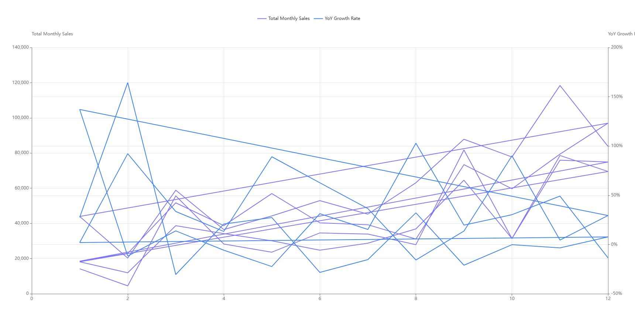

Slide 5
Discount-Profit Correlation Significance
Discount-Profit Connection: A slight trend shows that bigger discounts lead to smaller profits (correlation of -0.219).
Statistical Proof: The trend is reliable, confirmed by a very low p-value (2.702e-109).
Business Advice: Large discounts can hurt profits, so businesses should avoid aggressive discounting to maintain better profit margins.

Slide 6
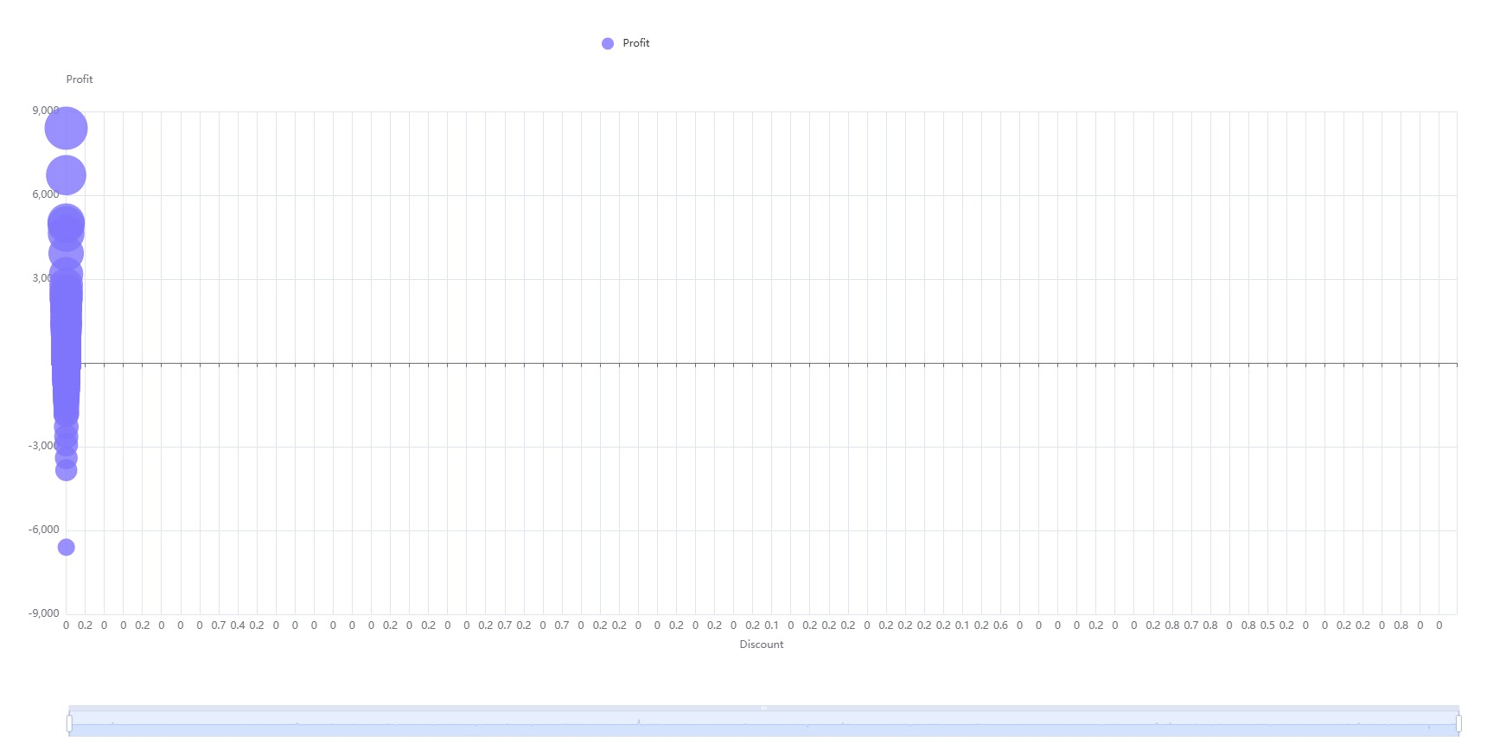

Slide 7
Identify Outliers in Sales Values
Unusual Orders: 127 orders stood out because their sales were much higher than usual, ranging from $2,104.55 to $22,638.48, with an average of $4,060.10.
Profit Ups and Downs: Profits varied widely, from a loss of $6,599.98 to a gain of $8,399.98, with an average profit of $747.74. This shows that big sales don’t always mean big profits.
Visual Summary: A boxplot (a type of chart) highlights these unusual orders and shows that the sales data is uneven, with a few very high sales stretching out the pattern.

Slide 8
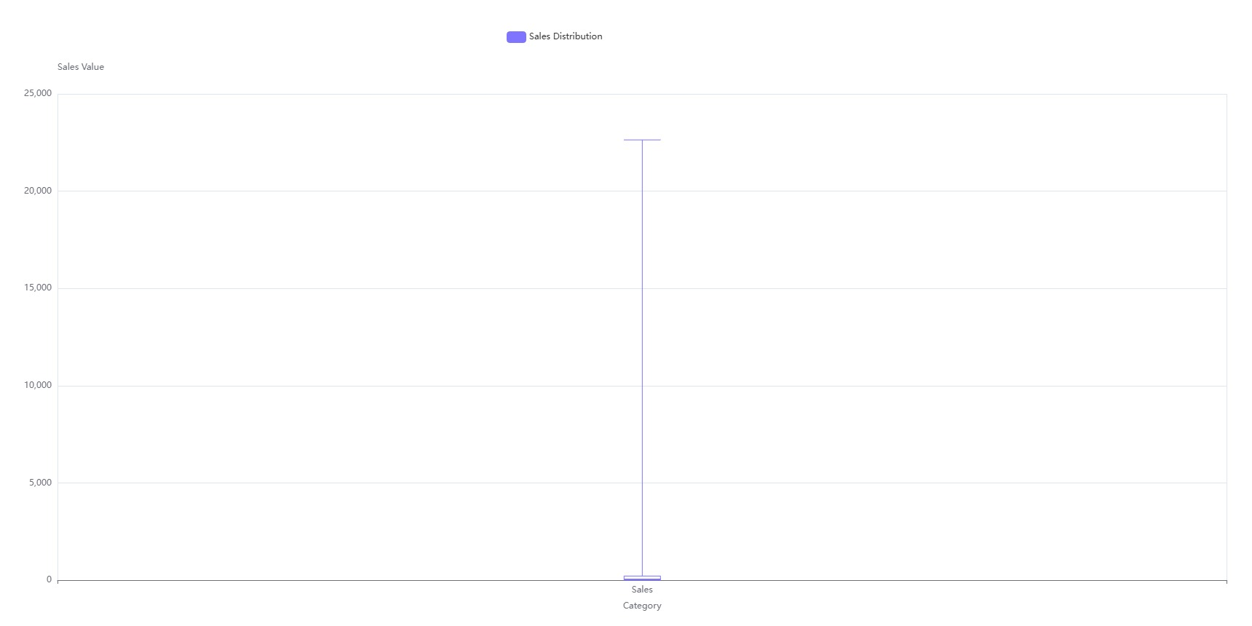

Slide 9
Sales by Customer Segment Analysis
Main Customers: The Consumer group buys the most, bringing in $1,161,401.34 from 2,586 orders, making them the biggest source of revenue.
Corporate Buyers: The Corporate group comes in second, with $706,146.37 in sales from 1,514 orders.
Home Office: The Home Office group buys the least, with $429,653.15 in sales from 909 orders.

Slide 10
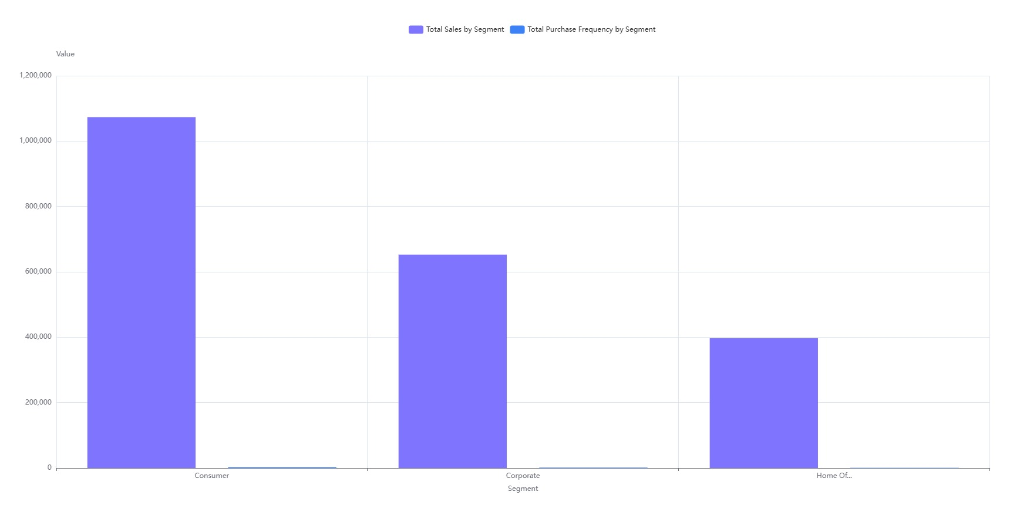

Slide 11
Sales and profit by category
Technology: This category makes the most money, with $836,154.03 in sales and a high profit margin of 17.40%, meaning it’s the most profitable.
Furniture: Sells a lot, bringing in $741,999.80, but has a low profit margin of 2.49%, so it’s not as profitable.
Office Supplies: Brings in $719,047.03 in sales and has a strong profit margin of 17.04%, making it quite profitable too.

Slide 12
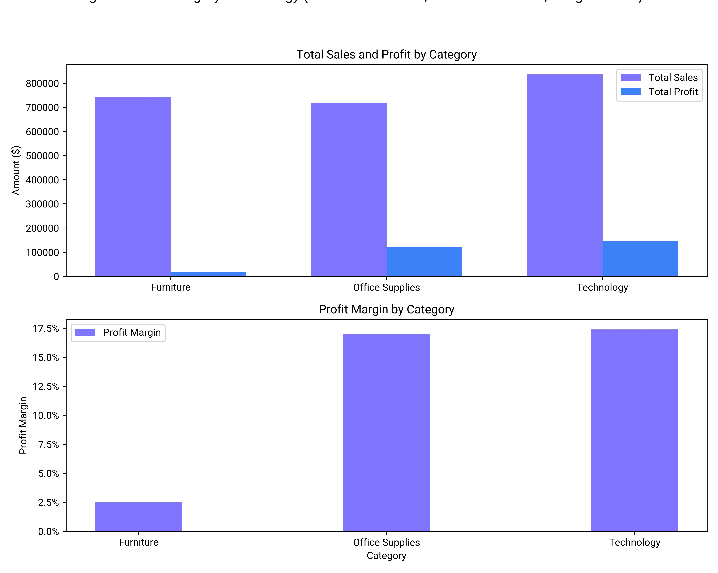

Slide 13
Regional Sales and Growth Rate
Sales by Region (2014–2017): The West region had the highest sales at $725,457.82, with the East region close behind at $678,781.24.
Fastest Growth: The Central region grew the most in 2016, with sales jumping by 43.31%.
Key Takeaways: The West region was the top seller overall. The Central region had up-and-down growth. The East region grew steadily. The South region bounced back strongly after a weaker 2015

Slide 14
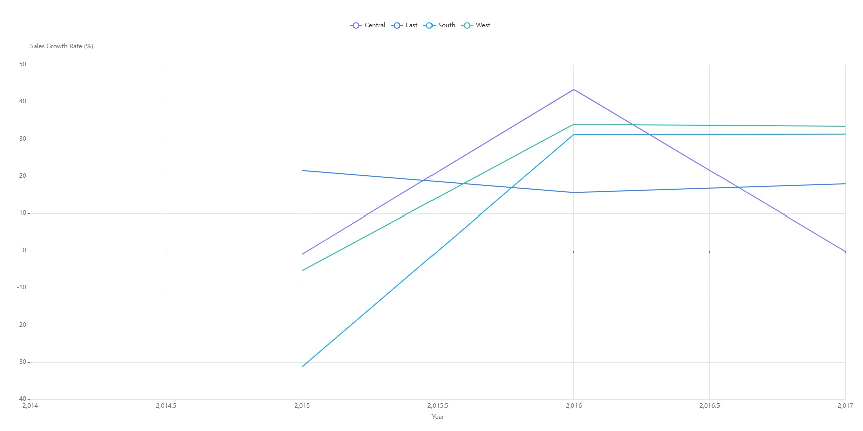

Slide 15
Order distribution and delivery time
Order Numbers and Delivery Time: Standard Class is the most popular shipping option with 5,968 orders, but it takes the longest to deliver at about 5 days. Same Day shipping is the fastest at 0.04 days (almost instant), but it has the fewest orders at 543.
What Customers Want: Customers prefer Standard Class, likely because it’s cheaper, even though it’s slower.
Business Tip: Companies should improve their shipping processes to handle high order volumes while offering faster delivery options to meet different customer needs.

Slide 16
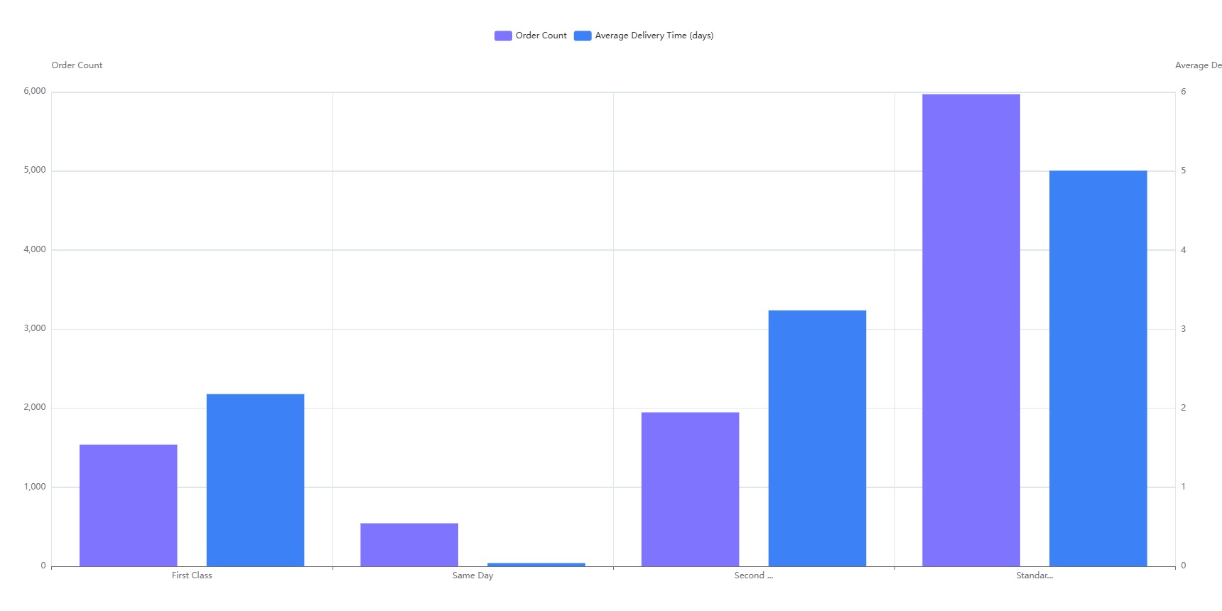

Slide 17
State Profit Analysis
Profit Differences: Profits vary a lot by state. California makes the most profit at $76,381.39, while Texas loses money, with a loss of $25,729.36.
Top and Bottom States: California and New York bring in the most profits, but Texas, Pennsylvania, and Ohio are struggling and need improvement.
Regional Patterns: States on the West Coast and in the Northeast are doing well with profits, while some Southern and Midwest states are not performing as strongly.

Slide 18
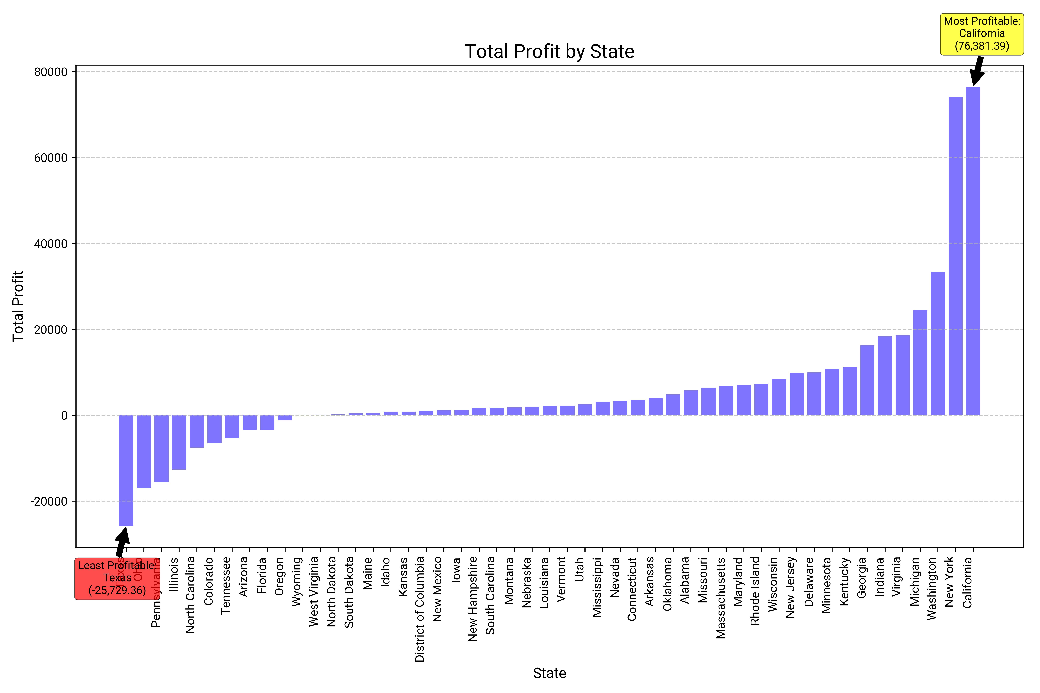

Slide 19
Analyze declining sales factors
Falling Sales in Machines: The "Machines" category is seeing a drop in sales and has a very low profit margin of only 1.79%.
Big Discounts Hurt Profits: Offering an average discount of 30.61% means prices are being cut a lot, which is reducing profits and sales.
What to Do: The business needs to rethink its pricing, improve the value of the machines, and check if there’s enough demand to boost sales.

Slide 20
Optimal Discount Rate for Profit
Best Discount Rate: For Furniture, Office Supplies, and Technology, offering no discount (0%) leads to the highest profits.
Discounts Hurt Profits: The more you increase discounts, the lower your profits get, and high discounts can even lead to losses.
Sales vs. Profits: Discounts might increase sales, but they often reduce profits, showing you have to choose between selling more or earning more per sale.

Slide 21
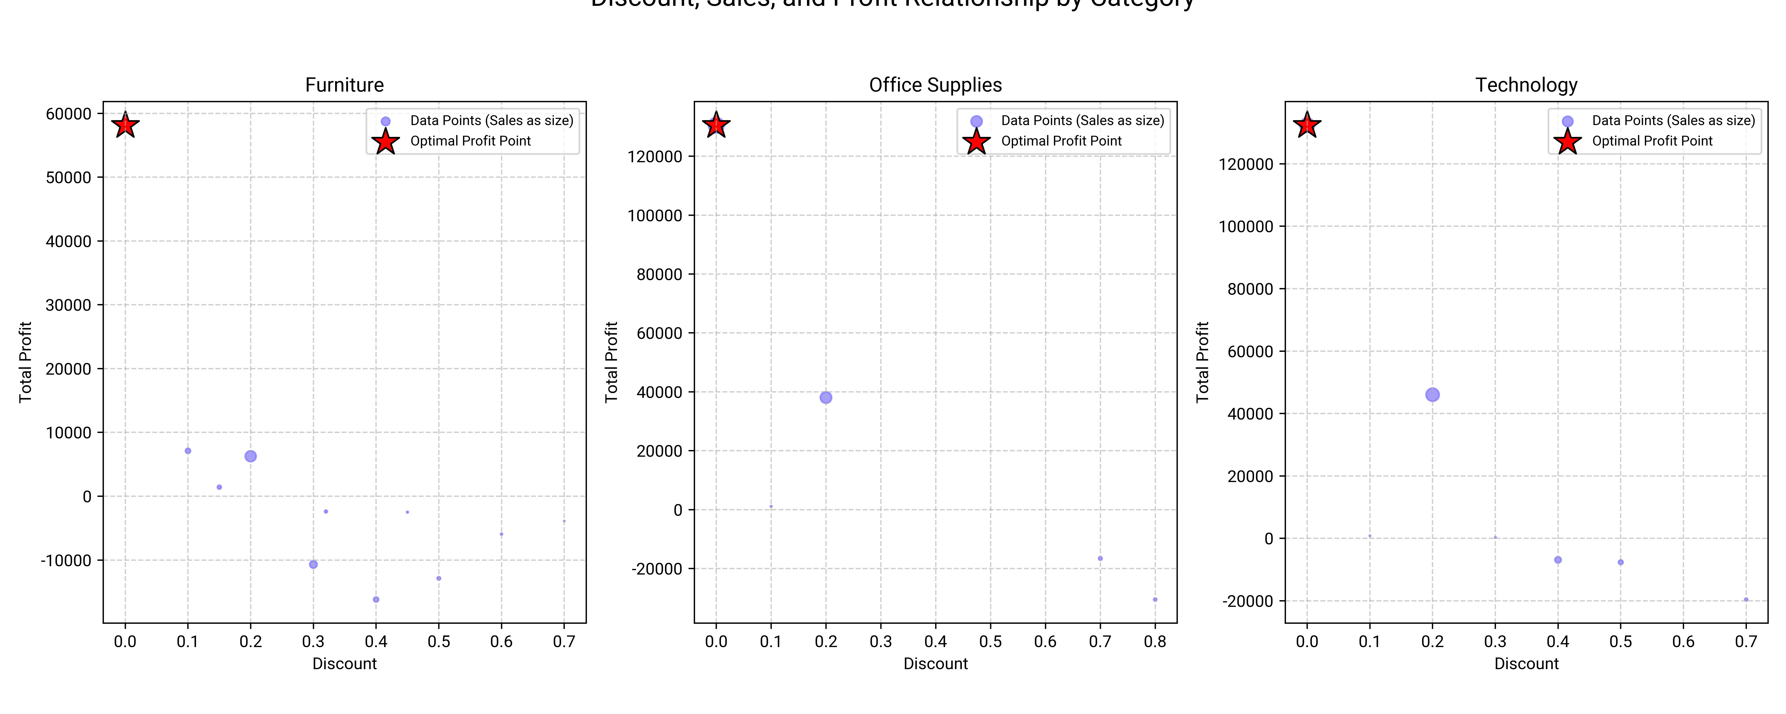

Slide 22

tapenderpundir21@gmail.com
Tapender Thakur

